Slide 1
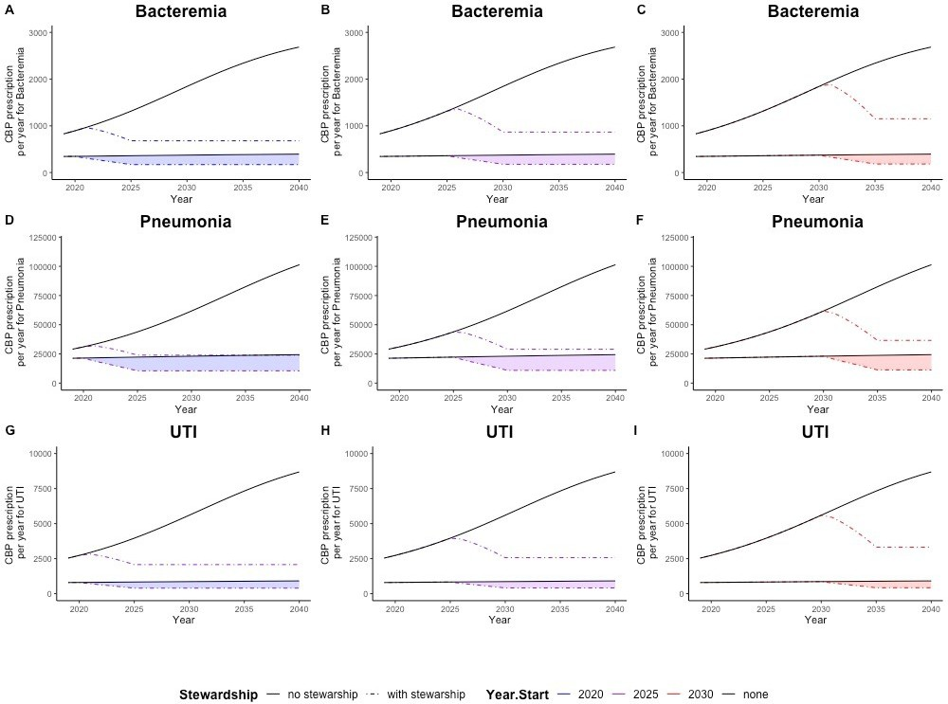
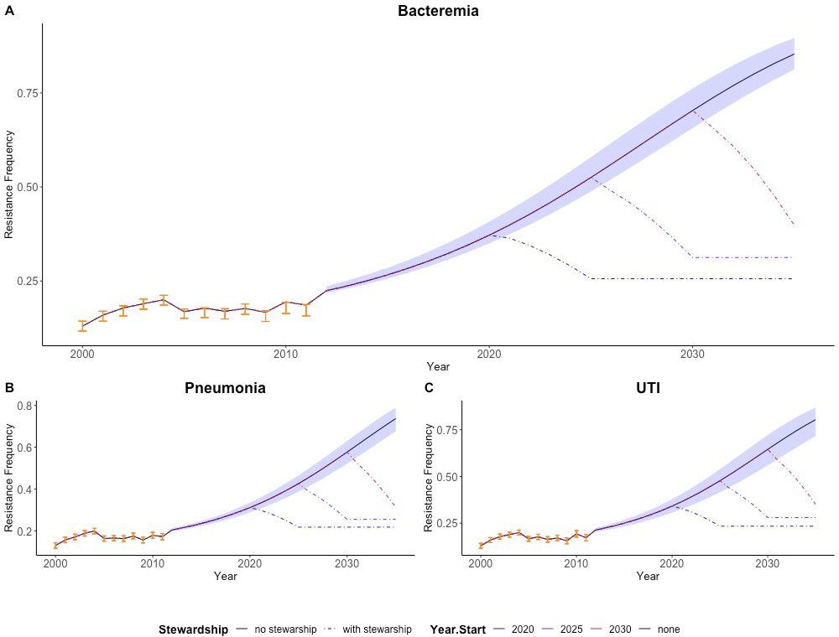
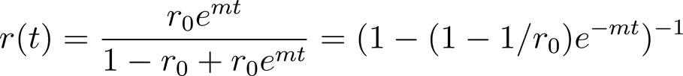




The Impact of Carbapenem-Sparing Interventions on the Evolution of Resistance in Pseudomonas aeruginosa in the United States
Jeffrey P. Townsend¹; Abhishek Pandey²; Yiziying Chen³; Amber B. Tang⁴; Eric M. Foster⁵; Dilip Nathwani⁶; Sanjay Merchant⁷; Eric Sarpong⁷; Meagan C. Fitzpatrick⁸; Alison P. Galvani⁹
¹Department of Biostatistics, Department of Ecology & Evolutionary Biology, Yale University, New Haven, CT, USA; ²Center for Infectious Disease Modeling and Analysis (CIDMA), Yale University, New Haven, CT, USA; ³School of Public Health, Yale University, New Haven, CT, USA; ⁴David Geffen School of Medicine, UCLA, Los Angeles, CA, USA; ⁵Yale University, New Haven, CT, USA; ⁶Ninewells Hospital and Medical School, Dundee, Scotland; ⁷Center for Observational & Real-World Evidence, Merck & Co., Inc., Kenilworth, NJ, USA; ⁸Center for Vaccine Development and Global Health, University of Maryland School of Medicine, Baltimore, MD, USA; ⁹CIDMA, Yale University, New Haven, CT, USA
Background
Carbapenem resistance (CR) among P. aeruginosa infections is a pressing public health concern in the United States. Therapeutic alternatives for CR infections are limited. Implementation of a key antimicrobial stewardship intervention such as formulary restriction, which is one of the many stewardship strategies, can minimize selection pressure for resistance. We evaluate the consequent impact of this intervention for carbapenems on Bacteremia, Pneumonia, and UTI patients infected with Pseudomonas aeruginosa in the United States.
Figure 1. Overall and Inappropriate CBP prescription for P. aeruginosa under Status Quo vs. Stewardship Interventions
where ⍴ is a fitted parameter that conveys the degree to which selection is affected by counterproductive
prescription, a_{y} quantifies the amount of counterproductive
prescription for the year y, and θ is the difference between the exponential growth rate of susceptible bacteria and the exponential growth rate of resistant bacteria in the absence of antibiotics.
Table 2. Prevented Cases of Carbapenem-resistant
P. aeruginosa Infection in the US Between 2025 and 2040
Stewardship Start Year | Bacteremia | Pneumonia | UTI
2020 | 29,600 | 1,051,600 | 110,300
2025 | 23,500 | 867,000 | 88,600
2030 | 15,200 | 600,000 | 58,700
Resistance per year (r_{y} for the year y) can be computed recursively:
where y = y₀ + n, n is a natural number, y₀ represents the initial year, the time t = 0 corresponds to the first day of the year y₀, the time unit is years, and r_{y} is measured at the middle of the year y.
Conclusions
Antimicrobial stewardship is a coordinated program that promotes the appropriate use of antimicrobials with the objective of decreasing antimicrobial resistance and eventually improving patient outcomes. Our study establishes, for the first time, spatially-averaged national-scale impacts of carbapenem restriction as a part of antibiotic stewardship programs that are developed to balance public health and individual medicine
We demonstrate that timely restriction of carbapenem consumption could markedly reduce future CR in
P. aeruginosa bacteremia patients. Implementing
early carbapenem restriction should be expected to result in a lower ultimate frequency of CR and a lower number of cumulative cases of resistant infections, thereby decreasing the overall burden of CR cases that will be encountered in the future
Methods
We developed a Malthusian population-genetic model of selection for CR. Increases in CR were modeled as a
consequence of inappropriate prescription. Inappropriate
prescription was estimated from a retrospective cohort study of inappropriate empiric treatment,¹ and future projections were based on historical resistance
frequencies and yearly carbapenem (CBP) consumption
associated with P. aeruginosa bacteremia. We projected peak P. aeruginosa CR frequencies and cumulative CR cases from 2020–2040. We compared scenarios without any carbapenem restriction to those in which carbapenem usage was decreased linearly to 51.7% of levels at implementation, as achieved in previous AMSP,² with
5-year rollouts starting in 2020 (early) or 2030 (late).
Figure 2. Observed and Projected Carbapenem Resistance Frequencies for P. aeruginosa
Overall and inappropriate CBP prescription across US under status quo (grey solid line) and under stewardship interventions beginning in 2025 (dot-dashed blue line), 2030 (dot-dashed purple line), and 2035 (dot-dashed red line) to treat a
P. aeruginosa infection causing bacteremia (A–C), pneumonia
(D–F), and UTI (G–I), implemented in 2025 (A, D, G), 2030 (B, E, H), or 2035 (C, F, I), projected assuming constancy of the 2011 prevalence of pneumonia, bacteremia, and UTI (HCUP), and of levels of carbapenem prescriptions (CDDEP).
Results
Table 1. Projected Carbapenem Resistance Frequencies Among P. aeruginosa Cases in 2040
Model
For a given pathogen, the resistance frequency at time t, r(t), starting at initial frequency r₀ can be modeled as:
References
Zilberberg MD, et al. BMC Infect Dis. 2017;17(1):279.
Van Hollebeke M, et al. Med Mal Infect. 2016;46(2):72-78.
Hartl DL, Clark AG. Principles of Population Genetics. 4th ed. Sunderland, MA: Sinauer Associates, Inc. Publishers; 2007.
Johnsen et al. J Antimicrob Chemother. 2011 Mar; 66(3): 608–610.
Austin DJ, Kristinsson KG, Anderson RM. Proc Natl Acad Sci USA. 1999;96(3):1152-1156.
Stewardship Start Year | Bacteremia | Pneumonia | UTI
Neverª | 86.0% | 75.6% | 89.6%
2020 | 23.2% | 19.9% | 23.6%
2025 | 28.7% | 23.5% | 30.1%
2030 | 36.6% | 28.6% | 39.4%
Observed resistance frequencies and 95% confidence intervals (orange circles and error bars) spanning 2000– 2011, and model fit (black line) and 95% confidence interval (blue bands) for projected carbapenem resistance frequencies spanning 2000–2035, and observed frequencies (orange points) among P. aeruginosa cases with bacteremia (A), pneumonia (B), and UTI (C) under status quo.
where m is the Malthusian selection coefficient.^{3,4}
Selective pressure from inappropriate antibiotic prescription increases the relative fitness of resistant bacteria,⁵ therefore we assume that the selection coefficient m is time dependent:
Parameterization and Model Fitting
Data
References
ªUnder a theoretical scenario without any antibiotic restriction.
Presented at IDWeek 2020; October 21-25, 2020.
Copyright © 2020 Merck Sharp & Dohme Corp., a subsidiary of Merck & Co., Inc. All rights reserved.

